Slide 1
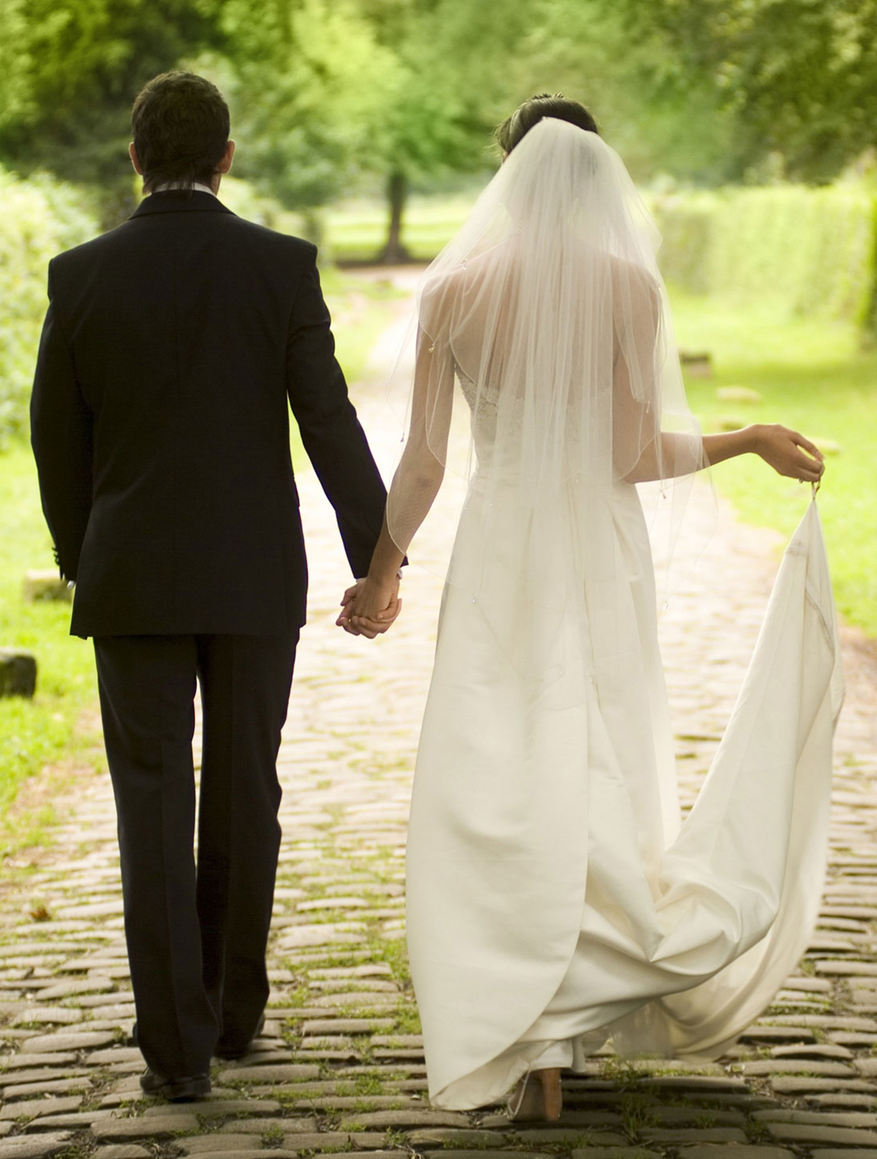
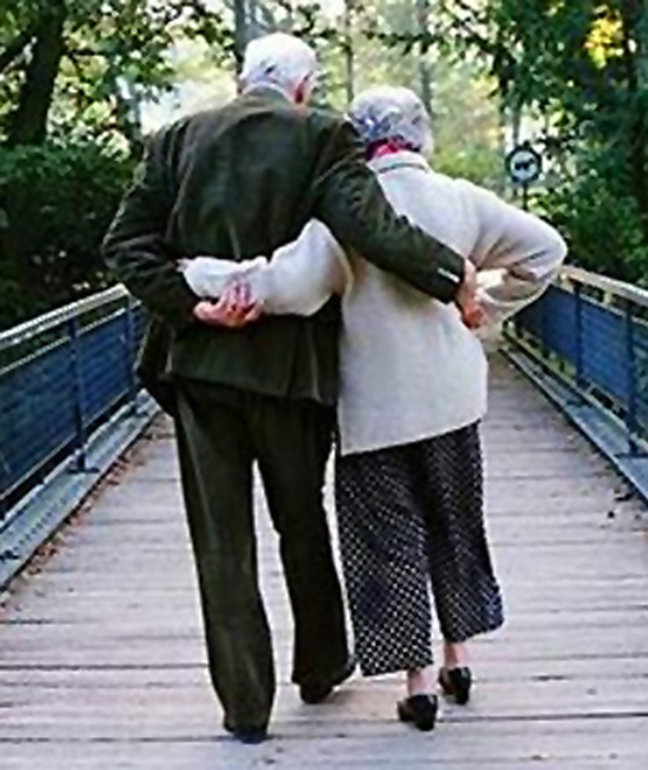
Married: Growing & Serving Together
The Permanent Covenant of Marriage
A Study of Marriage, Spring 2023

Slide 2
Covenantal Relationships
Covenant relationships are found all throughout the Bible.
Entering into covenants was a major part of what it meant to live in the ancient Near East. God explained His relationship with His people through a structure they already understood. A covenant is a relationship between two partners who make binding promises to each other and work together to reach a common goal. They’re often accompanied by oaths, signs, and ceremonies. Covenants define obligations and commitments like a contract, but most covenants are typically more relational and personal. Most covenants are between people who are relatively equal in status. However, some ancient covenants were agreements made between two unequal parties like a ruler and his subjects (suzerain covenant). God’s covenants with people resemble suzerain covenants and some (not all) are uniquely unconditional.
Notes:
Suzerain – “soo-zer-uhn”

Slide 3
What is a Covenant?
“Covenant” in the Hebrew O.T. - “Berith,” occurs 284 times
According to Strongs Concordance: Berith is thought to be derived from “Barah” [meat or to eat] in the sense of cutting; meaning a compact...made by passing between pieces of flesh.
See Genesis 15:9-10, 17-18; Jeremiah 34:8-22
“So the Lord said to him, “Bring me a heifer, a goat and a ram, each three years old, along with a dove and a young pigeon.” Abram brought all these to him, cut them in two and arranged the halves opposite each other; the birds, however, he did not cut in half... When the sun had set and darkness had fallen, a smoking firepot with a blazing torch appeared and passed between the pieces. On that day the Lord made a covenant with Abram and said, “To your descendants I give this land, from the Wadi of Egypt to the great river, the Euphrates”
“Covenant” in the Greek N.T. – “Diatheke,” occurs 33 times
Defined as: (a) a disposition, arrangement, will or testament (the ordinary, everyday sense, found countless times in papyri) (b) a compact or covenant.
Notes:
“Burr-eat” To make a covenant was literally in Hebrew “cut the meat”
“Dee-ath-ay’-kay”

Slide 4
Covenants Between Humans in the Bible (Partial List)
Abraham and Abimelech – Gen. 21:22-32
Isaac and Abimelech – Gen. 26:28-33
Jacob and Laban – Gen. 31:43-54
Joshua and the Gibeonites – Joshua 9
David and Jonathan – 1 Sam. 18, 23
David and Abner – 2 Sam. 3:12-21
King Solomon and King Hiram – 1 Kings 5:1-12
Major Covenants Between God and Humans
Noahic Covenant – Gen. 8:20-9:17
Abrahamic Covenant – Gen. 12, 15, & 17
Mosaic Covenant – Ex. 19-Deut. 34
Davidic Covenant – 2 Sam. 7, Ps. 72, 89, 132
New Covenant – Jer. 31:31ff, Ezek. 36:22ff, Mt. 26:26ff, Lk. 22:19ff
Notes:
Abraham and Abimelech made a covenant of peace at Beersheba, which means “well of the oath”
Most of God’s covenants have an associated symbol or reminder attached to them – rainbow / circumcision / Passover & Sabbath / David’s throne / Lord’s Supper & Baptism

Slide 5
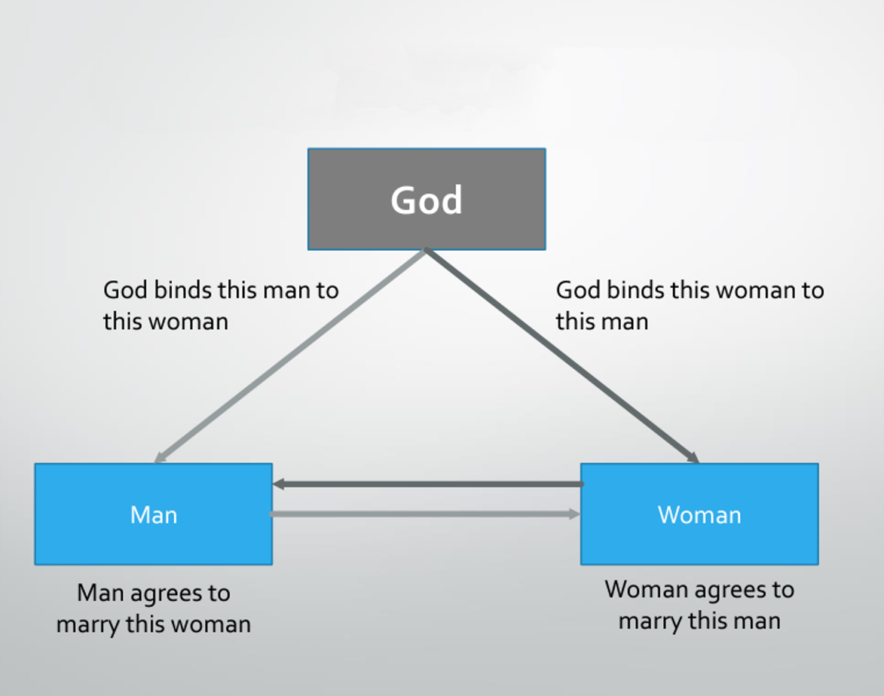
Marriage: A Three-Way Covenant
" John Doe, do you take Jenny Jones to be your lawfully wedded wife, to have and to hold from this day forward? Do you promise and covenant, before God and these witnesses to love her, comfort her, honor and keep her for better or worse, for richer or poorer, in sickness and in health, and forsaking all others, be faithful only to her, for as long as you both shall live?”
“Therefore what God has joined together, let no one separate.” – Matt. 19:6b
“For a married woman is bound by law to her husband while he lives.” – Rom. 7:2
“She is your partner, the wife of your marriage covenant.” – Mal. 2:14b; Ezek 16
“She has abandoned her husband and ignores the covenant she made before God.” – Prov. 2:17
Notes:
Marriage is described in several Bible passages as a covenant, but it’s not just between the man and the woman. God is a party to the marriage covenant and binds the two together.
The couple make vows to each other, but they are also making promises to God. (Traditional wedding ceremonies begin with the man and woman facing the minister as he has them pledge their intent. Later, they turn and face each other and make more vows and exchange rings).

Slide 6
Typical Differences Between Contracts and Covenants
Contracts
Fueled by distrust
Protect the interests of each party
“Short” term - Can be terminated or renewed by mutual consent
Govern consumer/vendor relationships
Covenants
Based on trust
Committed to protection of the relationship
Long term – may be lifelong, multigenerational or permanent
Govern relationships by combining law and love

Slide 7
The Commodification of Marriage
“Sociologists argue that in contemporary Western society the marketplace has become so dominant that the consumer model increasingly characterizes most relationships that historically were covenantal, including marriage. Today we stay connected to people only as long as they are meeting our particular needs at an acceptable cost to us. When we cease to make a profit—that is, when the relationship appears to require more love and affirmation from us than we are getting back—then we “cut our losses” and drop the relationship. This has also been called “commodification,” a process by which social relationships are reduced to economic exchange relationships, and so the very idea of “covenant” is disappearing in our culture. Covenant is therefore a concept that is increasingly foreign to us, and yet the Bible says it is the essence of marriage.” - Tim Keller, The Meaning of Marriage

Slide 8
Consumer or Covenantal Relationship?
Consumer
Relationship lasts only as long as the vendor meets the consumer’s needs at an acceptable cost
Consumer is always looking for a better product or service and a better price
Relationships are nice, but there’s little loyalty if an individual's needs are no longer met or an individual determines he would be better served by another supplier
Individual needs take precedence over the relationship
Can be an unstable relationship and marked by “FOMO” anxiety.

Slide 9
Consumer or Covenantal Relationship?
Covenantal
Both parties agree to a long-term binding commitment to put their spouse and their relationship first.
We become bound by both law and love (like parenting)
The “piece of paper,” rather than stifling freedom, creates a cradle of security for our fears and allows us to be vulnerable
Relationship can be more intimate because it is more stable.
The marriage vows reflect the covenantal nature of the commitment the couple is making – “for better or worse...”
The relationship takes precedence over the immediate needs of the individual
Honoring the marriage covenant is essential if a couple is to persevere through the tough times to build something great together.
Notes:
The modern view is that marriage is “just a piece of paper.” The idea is that a relationship should sizzle with sexual attraction and emotion and any sense of duty to a legal commitment would actually stifle those feelings. That’s the view of many who see marriage as confining and archaic. But rather than being confining, marriage provides security and freedom. Tough times like when Ulysses had himself tied to the mast.

Slide 10
The Power of Promising
“Vows keep you from simply running out too quickly. They give love a chance and create stability so the feelings of love, always very fitful and fragile in the early months and years, can grow strong and deep over time. They enable your passion to grow in breadth and depth, because they give us the security necessary to open our hearts and speak vulnerably and truthfully without being afraid that our partner will simply walk away... It is the signing of that “piece of paper,” or walking through animal parts, or stomping on the glass, or jumping the broomstick, or whatever way your culture provides to make a solemn, public vow to which you are held accountable. Love and law go hand in hand. That’s because, according to the Bible, marriage is essentially a covenant.” - Tim Keller, The Meaning of Marriage
“Like everything which is not the involuntary result of fleeting emotion but the creation of time and will, any marriage, happy or unhappy, is infinitely more interesting than any romance, however passionate.” – W. H. Auden, A Certain World: A Commonplace Book

Slide 11
The Power of Promising
When you make a promise to someone, “you have created a small sanctuary of trust within the jungle of unpredictability... I am well aware that much of what I am and what I do is a gift or a curse from my past. But when I make a promise to anyone, I rise above all the conditioning that limits me. No German shepherd ever promised to be there with me. No home computer ever promised to be a loyal help. . . . Only a person can make a promise. And when he does, he is most free.” Lewis Smedes, Controlling the Unpredictable – The Power of Promising
“Commitment is what transforms a promise into reality. It is the words that speak boldly of your intentions. It is the actions that speak louder than words. It is making the time when there is none, coming through time after time, year after year. Commitment is the stuff character is made of, the power to change the face of things. It is the daily triumph of integrity over skepticism” – unattributed quote by Brent Hunter

Slide 12
“LORD, who may dwell in your sacred tent? Who may live on your holy mountain? The one whose walk is blameless, who does what is righteous, who speaks the truth from their heart... who keeps an oath even when it hurts, and does not change their mind” – Psalm 15:1,2,4b
Notes:
The Scriptures have a lot to say about commitment and integrity and keeping our promises no matter what.

Slide 13
Build a “Sacred History” Together
“Half the battle, then, is just keeping our story alive, refusing to quit, believing that if we keep hanging in there, we’re giving God more time and more opportunities to work his grace into our lives. It’s not easy, but it’s sacred and it’s strong, and it leaves a lasting legacy.”
– Gary Thomas, Sacred Marriage
“Tell your [marital] story. Tell it to your kids, your friends, your brothers and sisters, but especially to each other. The more your story is implanted in your brain, the more it serves as a hedge against the myriad forces that seek to destroy your marriage. Make your story so familiar that it becomes part of the fabric of your being. It should become a legend that is shared through the generations as you grow a family tree that defies all odds and boasts marriage after marriage of stability, strength, and longevity.” – Jerry Jenkins, Hedges: Loving Your Marriage Enough to Protect It

Slide 14
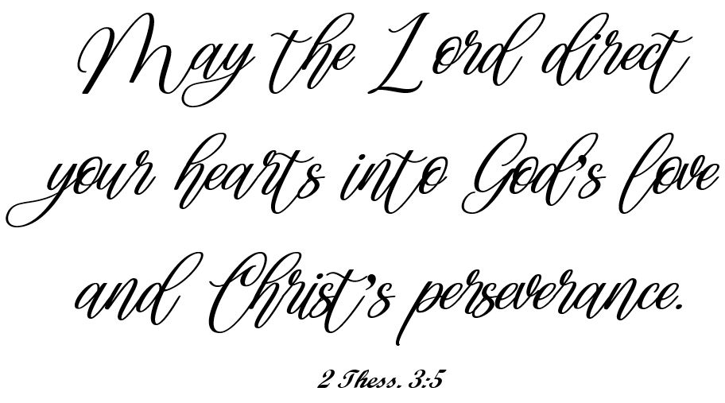
Keys to Remain Committed to Our Marital Covenant:
Notes:
Traits We Should All Develop as Christians
Gary Thomas called Second Thessalonians 3:5 “One of the most poetic lines in Scripture,” one he wished every husband and wife would display in a prominent place in their home.
We need to love like God loves and persevere as Christ persevered.

Slide 15
Agape Love and Our Love Tank
In “The 5 Love Languages,” Gary Chapman paints an ideal marriage as one where each spouse keeps the other’s love tank full by regularly expressing love using the right language.
But sometimes our own love tank may be running low, and our spouse is either unable or unwilling to fill it.
This may be due to some ongoing conflict or stress, or we may be making the mistake of expecting our spouse to fill up our tank in a way that only God can.
Such times test our perseverance to keep on showing our spouse unconditional agape love without becoming resentful.
Fortunately, God is love. He can always fill our love tanks through His influence and our appreciation of His unfathomable love of us.
Remember, we are to love as Christ loved the church.
Jesus did not look down from the cross thinking what lovely people we were. When we feel like giving up and leaving, don’t. Choose to love your wife and stay because He stayed.
Notes:
“Let the word of Christ dwell in you richly” – Col. 3:16 / “Be filled with the Spirit” – Eph. 5:18

